Slide 1

SunDial
Billing solutions for a work-from-home world.

Slide 2

Our world is working like never before.
More of the labor force is working from home than ever before in history. The opportunities are boundless, but they come with new challenges.
One of these is tracking time spent, both as an employee and an employer. This fundamental factor can be very difficult to record and communicate effectively, leading to time wasted for both parties.

Slide 3

Track time with ease and simplicity.
SunDial takes this challenge head on, with a simple, easy to use platform that allows work to be clearly and precisely communicated to the employer or client.
With the ability to create and track users and the projects they are working on, this webpage will help ease the challenges we are facing with a widely distributed workforce.

Slide 4
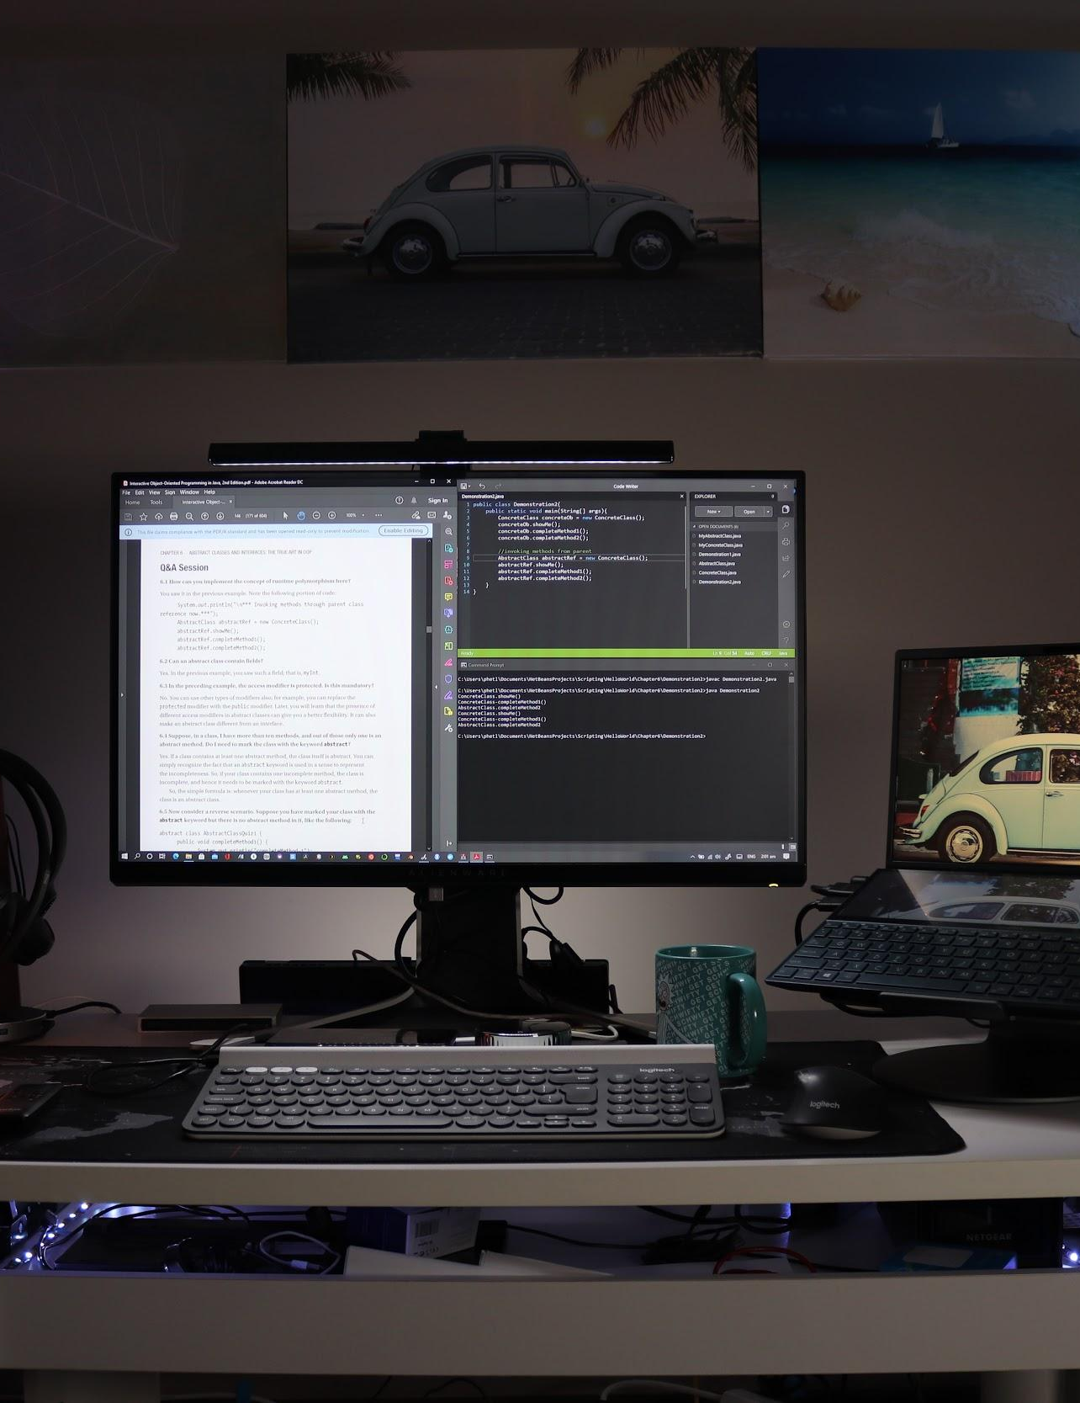
Concept
FIRST the user creates a user profile on the home page.
THEN the user is taken to the SHIFT page.
WHEN the user creates a project it is populated to the project list.
WHEN the user selects a project and clicks Start Shift the website records start time.
THEN the user may end shift or move to a 2nd task, beginning to record time. A log is created.

Slide 5

The Process
Frontend
Keenan Reed / Mike Belliveau
Backend
Aaron Parnell / Daniel Maier / Alejandro Carlos
Challenges
-
Successes
-

Slide 6

Direction for Future Development
In addition to time sheets SunDial will host project tracking pages.
UI will be refined and modified for ease of use.

Slide 7
Links
GitHub repository: https://github.com/DanZosh/POD_9_Proj_2
Deployed application: https://dry-forest-22741.herokuapp.com/

Slide 8
Attributions
Title Page: Image by Tomasz Hanarz from Pixabay
Page 1: Image by fancycrave1 from Pixabay
Track: Photo by Chris Montgomery on Unsplash
Concept: Photo by Boitumelo Phetla on Unsplash
The Process: Image by Marvin Meyer on Unsplash
Direction: Photo by Fabrizio Verrecchia on Unsplash

